Slide 1

Labyrinth Navigator: A 3D WebGL Game Experience
Built with JavaScript & Three.js

Slide 2



Game Concept & Objective
A first-person survival puzzle where players must escape a "breathing" labyrinth before time expires. The maze challenges spatial reasoning while immersing players in atmospheric tension.
Explore
Collect
Theme: "Shadow Passage" – An experience focused on atmosphere, dynamic lighting, and psychological tension.
Navigate a procedurally built 3D maze with dynamic pathways
Find the Green Crystal Key to unlock the exit portal
Escape
Reach the Portal to advance to the next level

Slide 3

Tech Stack & Tools
1
Three.js
Powers the 3D rendering engine, scene graph management, and camera systems. Handles WebGL abstractions for cross-browser compatibility.
2
JavaScript (ES6)
Modular architecture using Imports/Exports keeps code maintainable and scalable. Leverages modern syntax for cleaner development.
3
Tailwind CSS
Creates "Glassmorphism" UI overlays for Start Screen, Timer, and Win/Loss states with minimal custom CSS.
4
HTML5 Audio
Implements spatial audio system for immersive 3D sound effects that respond to player position and actions.

Slide 4

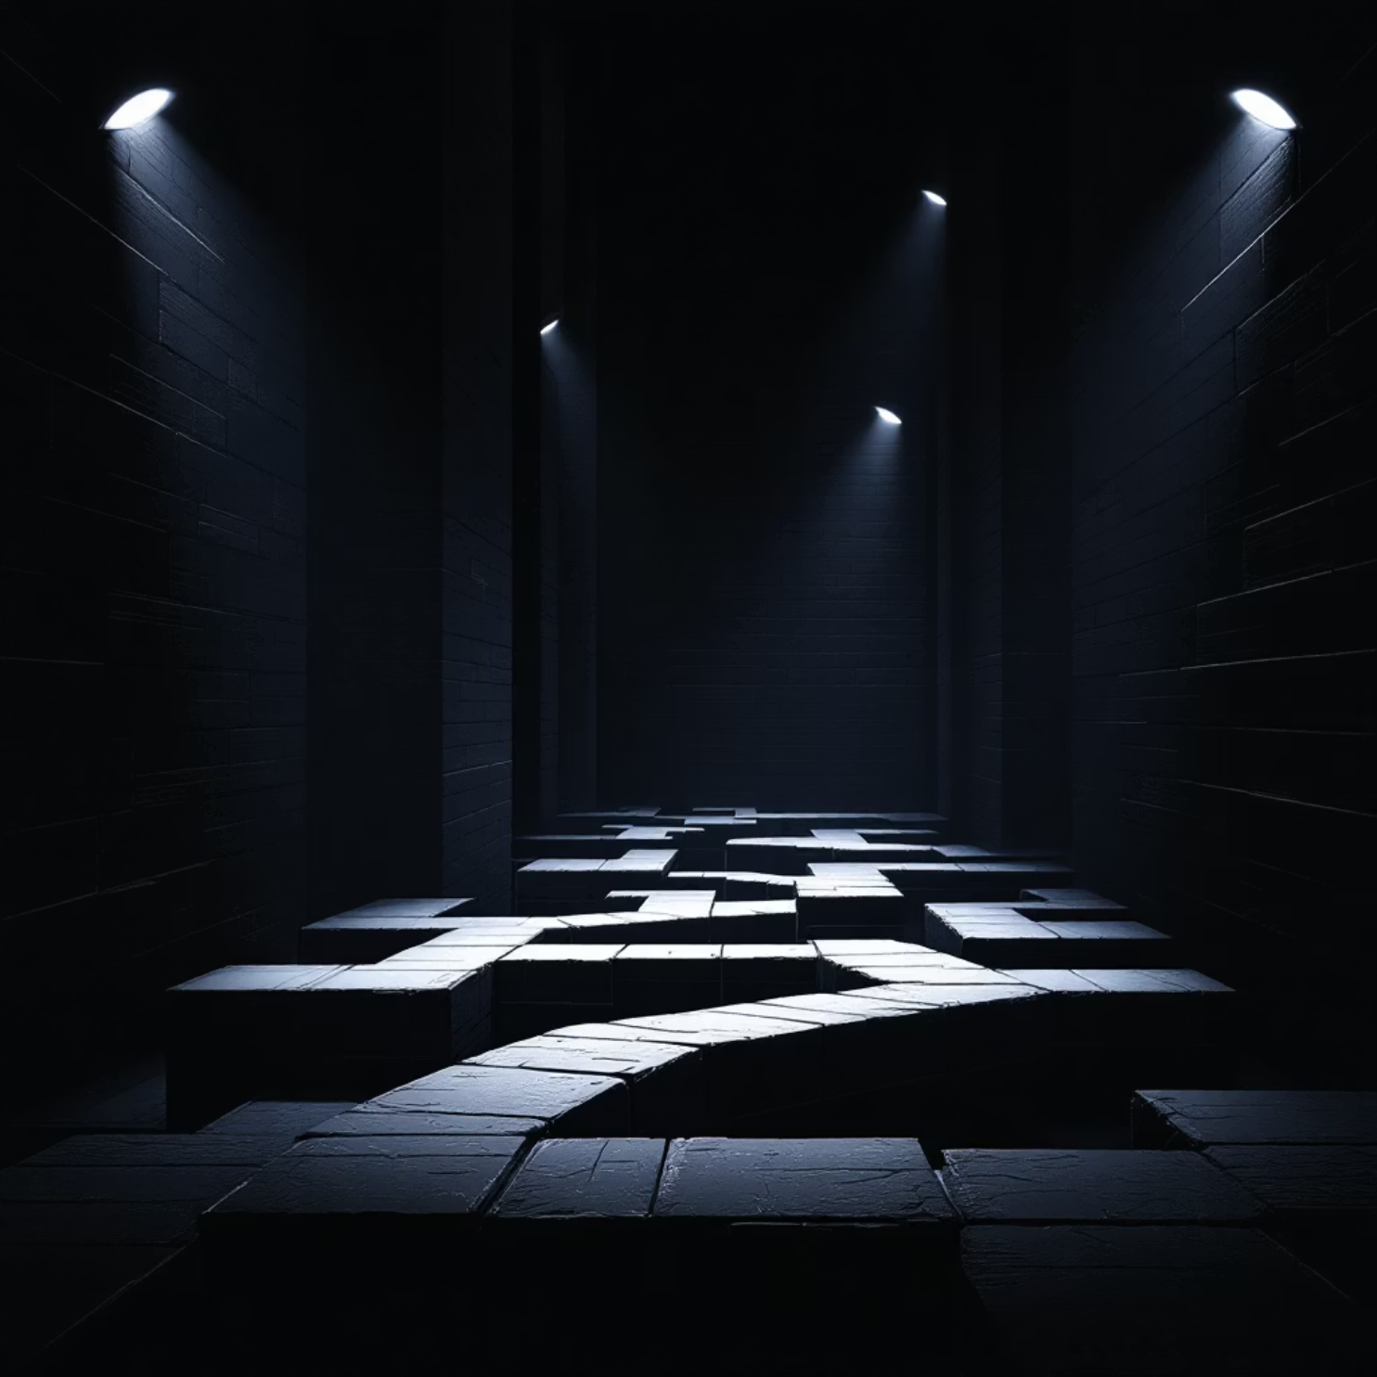


Graphics & Lighting Techniques
Dynamic Lighting
SpotLight attached to camera simulates a flashlight moving with the player, creating realistic shadow casting and atmospheric depth.
Texture Mapping
UV wrapping (THREE.RepeatWrapping) ensures brick and floor textures tile seamlessly without distortion or stretching artifacts.
Visual Feedback
Emissive materials on Keys and Portals create glowing effects visible in the dark maze, guiding player navigation.

Slide 5

System Architecture
Modular Design
Game Loop
The project is organized into distinct files for better maintainability and scalability:
Uses requestAnimationFrame to update physics, animations, and rendering at 60 FPS. This ensures smooth gameplay and responsive controls across different devices and browsers.
main.js: The "Brain" – Game Loop, State Management, Core Logic
The loop handles collision detection, camera updates, audio positioning, and UI state changes in a synchronized manner.
maze.js: The "Builder" – Generates walls from text data
player.js: The "Controller" – Input handling & physics

Slide 6




Level Generation Algorithm
Text-to-3D
Levels are designed as simple ASCII arrays – 2D grids of characters representing walls, keys, exits, and spawn points.
Parsing Logic
The engine reads the grid (W, K, E, S) and instantiates 3D meshes at correct world coordinates with proper scaling.
Scalability
This system allows for creating new levels effortlessly by typing new text arrays in constants.js – no modeling software required.

Slide 7
Key Technical Challenges
Problem 1: Height Collisions
The player (height 1.8 units) couldn't interact with the floating key positioned at height 3.0 units. Traditional 3D distance calculations failed because they factored in vertical separation.
Solution: Implemented a "Flat Distance" check that calculates the hypotenuse of X and Z coordinates only, ignoring height differences. This allows vertical collection zones.
Problem 2: Level Switching
Old levels would persist as "ghost objects" when loading a new map, causing memory leaks and visual artifacts. Objects remained in the scene graph despite level transitions.
Solution: Built a clearLevel() utility function that tracks and properly disposes of all meshes, geometries, materials, and colliders before building the next stage.

Slide 8

Live Gameplay Demo
1
Flashlight Effect
2
Key Collection
Dynamic spotlight illuminating brick textures with realistic shadow casting
Audio feedback and visual effects trigger when successfully collecting the key
3
Level Transition
4
Win Screen
Seamless progression from Level 1 to Level 2 with proper cleanup
Victory state displays upon completing the final maze challenge

Slide 9
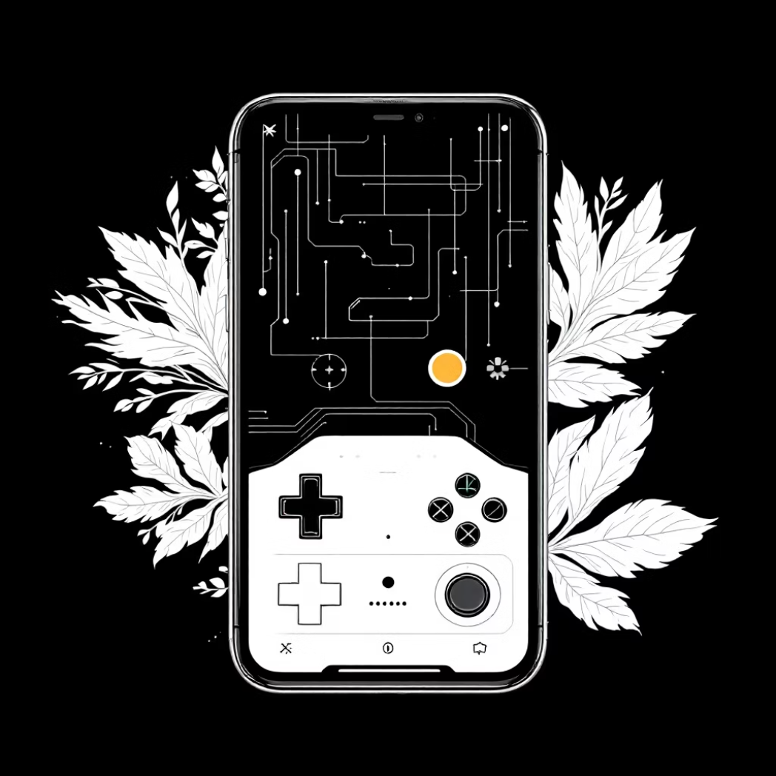
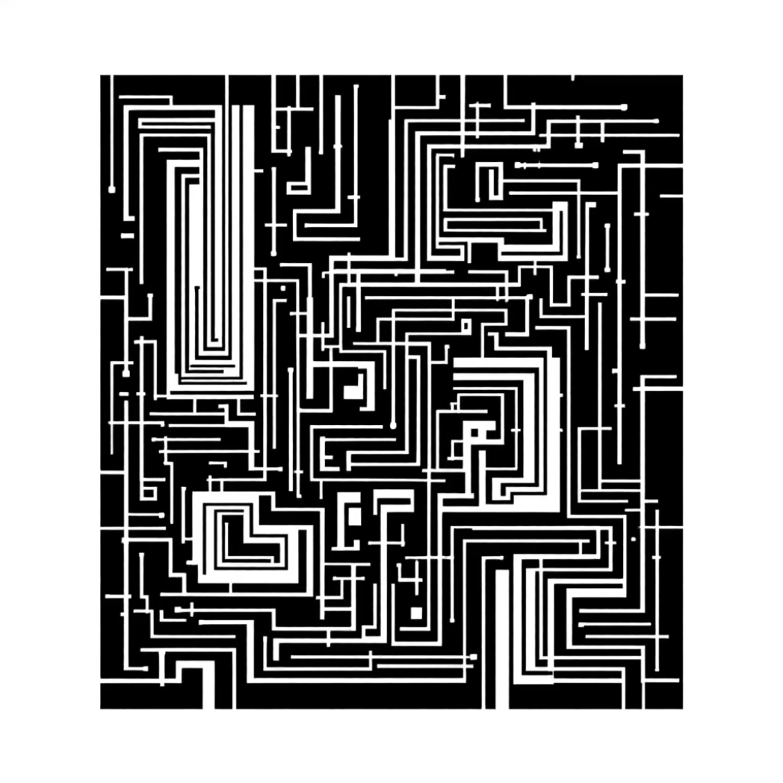
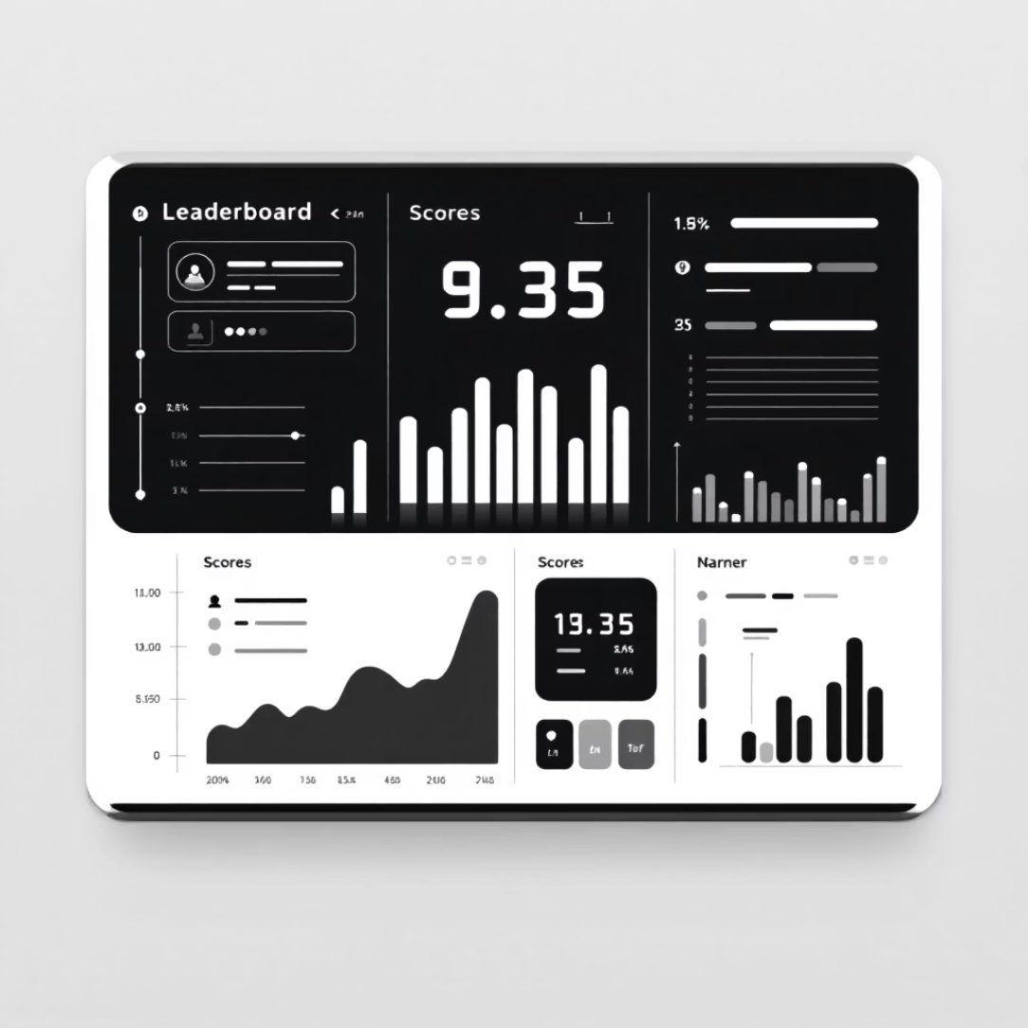
Future Roadmap
Mobile Support
Procedural Generation
Leaderboard System
Adding touch-screen joysticks and gesture controls for phone play. Optimizing performance for mobile GPUs and implementing responsive UI scaling.
Writing an algorithm (Depth-First Search or Recursive Backtracking) to generate infinite random mazes with guaranteed solutions.
Using Firebase or SQL database to save high scores, completion times, and player statistics for competitive gameplay.

Slide 10
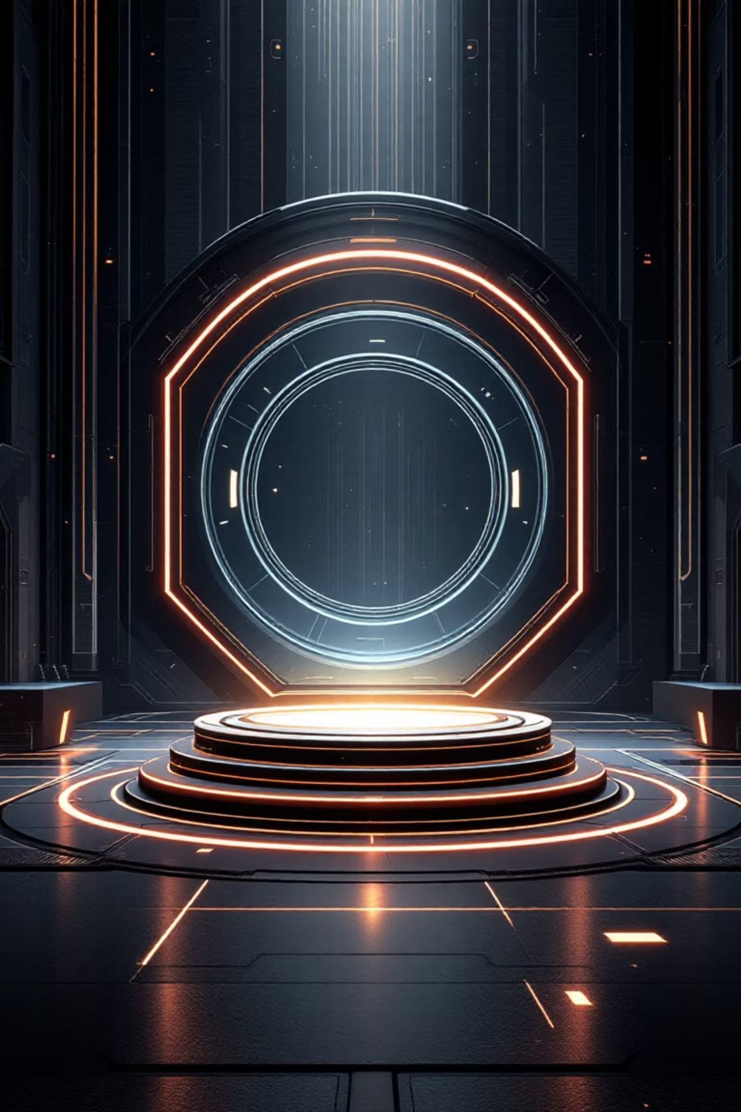
Thank You!
Questions & Discussion
Open floor for questions regarding code architecture, design decisions, or graphics implementation

